Slide 1
Capstone Project
Workforce Analytics
Submitted by:
PGP-DSE Gurgaon Jan’21-Group 7
Siddhanth Rawat
Pragyansh Sharma
Ritu Dhounchak
Divyanshi Verma
Urvashi Rawat
Under the Supervision of:
Mr. Vikash Chandra

Slide 2
Problem Statement
Company Information
NewJob_partner is a recruitment agency that specializes in providing efficient resources to various companies working in different fields.
Alpha Private. Limited has two positions open for the role of JR. Data analyst and senior data scientist. The job description for both the posts is as follows:
Junior Data Analyst: Experience 0-3 years
Stem Graduate, Any Postgraduate
Humanities and Business degree not required
Senior Data Scientist: Experience 10 or more years
Stem Graduate, Any Postgraduate, Any PhD
Humanities and Business degree not required
Alpha Private Limited collaborated with NewJob_partner to assist them in selecting the right candidate for the newly opened post.
NewJob_partner's databases contain information about a candidate's skills and experience and they apply various data-driven algorithms to analyze the gathered information of various candidates so that it can be used in valuable insights about a specific candidate's professionalism and preferences which proves out to be an excellent approach when filtering candidates as per client’s requirements.
Problem Statement: Estimate the likelihood of an applicant searching for a new career

Slide 3

Dataset Description
The dataset chosen by us consists of the columns that are described below.
The dataset primarily focuses on the various factors which might be affecting the job change which directly helps us to identify the factors for change and the candidates who are actually interested in moving onto new job roles/new careers.
S.No. | Column Name | Column Description | D-Type
1 | Enrollee_id | Unique ID for candidate | int64
2 | City | City code | int64
3 | City_ development_index | Development index of the city | object
4 | Gender | Gender of candidate | float64
5 | Relevent_experience | Relevant experience of candidate | object
6 | Enrolled_university | Type of University course enrolled if any | object
7 | Education_level | Education level of candidate | object
8 | Major_discipline | Education major discipline of candidate | object
9 | Experience | Candidate total experience in years | float64
10 | Company_size | No of employees in current employer's company | object
11 | Company_type | Type of current employer | object
12 | Last_new_job | Difference in years between previous job and current job | object
13 | Training_hours | training hours completed | int64
14 | Job Change | Looking for a job change or not | object

Slide 4
Data Preprocessing
Missing Values and its treatment
Outlier Detections and Treatment
Various Columns Treatment
Data preprocessing involves transforming raw data to well-formed data sets so that data mining analytics can be applied. Raw data is often incomplete and has inconsistent formatting.
To solve these pre-existing issues found the raw data we have performed the following preprocessing steps and taken certain actions to complete the data preprocessing part to covert the raw data into information so that insightful inferences can be extracted out of it.

Slide 5
Missing Values and its treatment
Column Name | Null Values (%)
sno | 0
enrollee_id | 0
city | 0
city_development_index | 0
gender | 0
relevent_experience | 0
enrolled_university | 2.01
education_level | 0
major_discipline | 0
experience | 0.33
company_size | 30.99
company_type | 32.04
last_new_job | 2.20
training_hours | 0
job_change | 0
Column Name | Null Values (%)
sno | 0
enrollee_id | 0
city | 0
city_development_index | 0
gender | 0
relevent_experience | 0
enrolled_university | 0
education_level | 0
major_discipline | 0
experience | 0
company_size | 0
company_type | 0
last_new_job | 0
training_hours | 0
job_change | 0
As we can see that the missing values present in the data are not that high and can be imputed.
So we have performed the individual imputation for each column on the basis of the individual analysis performed by us on the data by finding different patterns in the data keeping in mind not to harm the integrity of the data by wrong imputations. Some of the imputations are as follows:
Enrolled_university ➔ “no_enrollment”
Last_new_job ➔ “never”
Company_type ➔ “other”
Experience ➔ 10(has experience) & 4(no experience) [Bases on the patterns found in the data]

Slide 6
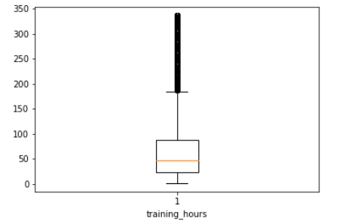
Outlier Detections and teatment
As our data mostly consisted of categorical columns there were a few numerical columns while the outlier could only be found in the training hours column. While the column with outliers should be transformed to outlier free column but here we can see that the training is a columns with values which cannot be considered in real world scenarios so though that analysis we have decided not to transform the column.
Various kinds of columns
As our data mostly consisted of categorical columns there were a few numerical columns, so we have performed the underlying steps:
Convert all categorical columns to machine readable values using pandas.get_dummies()
Columns like Sno,Enrollee_id and city were dropped as these were unique columns and had no contribution to the model in any manner
Column Name | Unique Value Count
sno | 19158
enrollee_id | 19158
city | 123

Slide 7

What inferences can be made
out of the dataset ??
The ratio for job change for gender
Relevant Experience affecting the job change
Education level of the respective candidates
Major discipline's role is affecting job change
Experience and training of employees

Slide 8
The ratio for job change
The ratio of male, female and other in our data is 84%:14%:2%.
The ratio of job change is 75%:25%
The individual ratio of job within male, female and other is 28%, 24% 30% respectively.
The others are more prone to look for new employment followed by female.

Slide 9
Relevant Experience affecting the job change
People with no relevant experience are more likely to look for jobs.
The ratio for the same is 34% : 22%

Slide 10
Experience and training of employees
On average employees with 8 years of experience are willing for a job change.
The employees with experience of 10+ are more reluctant to the
change
All major discipline has an avg mean
training time of 65-68 hrs
Major Discipline | Avg. Training Hours
Arts | 60
Business Degree | 66
Humanities | 66
No Major | 66
Other | 66
STEM | 65

Slide 11
Education level of the respective candidates
The maximum no. of candidates have graduate degree followed by masters and the lowest level of education is primary school.
Low people with higher education background Phd.
Education Level
Bifurcation

Slide 12
Major discipline's role is affecting job change
Employees with other STEM and business degree as major discipline more prone for job change if we see the people with their respective major disciplines only
Candidates looking for job change with education level of Graduate mostly have a major discipline in STEM ,Humanities and Other.

Slide 13
Statistical Analysis
Application of Chi-squared Independence of Attribute test represents that all the categorical columns are dependent on target columns.
The mean training hours of employees who change jobs is different than those who don’t change jobs.
The Avg Experience of people who change jobs is 8yrs as opposed to the actual avg experience of employees(10yrs).
There is no high correlation among the variables except a few after categorical columns transformation and pre-transformation there was low correlation among the numerical variables.
The only variables that have a substantial amount of correlation with the target column (job change) are experience, Private company ,city development index, company size of 50-99,and few others.

Slide 14
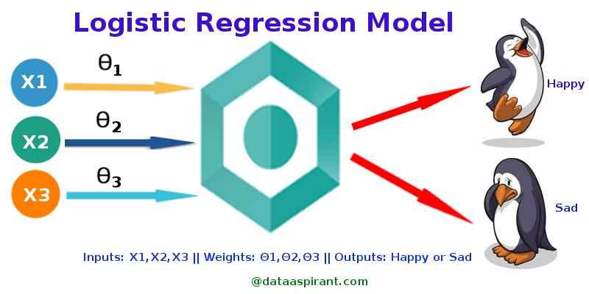
Base learner model
We have taken the Logistic Regression model as our base learner model for this project.
Why Logistic Regression???
Advantages of Logistics Regression :
Logistic Regression Are very easy to understand
It requires less training
Disadvantages of Logistics Regression :
Sometimes Lot of Feature Engineering Is required
If the independent features are correlated it may affect performance
It is often quite prone to noise and overfitting
Performance Metrics used in the Classification Model by us to validate the performance of the model are Confusion Matrix,Precision,Recall, F1 score,ROC-AUC score ,Model Score

Slide 15
Base learner model Report
Metrics Analysis
Name | Train Score | Test Score | Precision Score | Recall Score | F1-Score | ROC - AUC | TN | FP | FN | TP
Logistic Regression | 0.76934 | 0.77139 | 0.56264 | 0.25618 | 0.35207 | 0.76518 | 2718 | 185 | 691 | 238
From the above results we can see that the Logistic Regression model is performing quite ok is we consider the train and test scores but as we go on to analyze the precision ,recall and f1-scores we can find that it is doing a terrible job at classification as we can even see high False Negatives.

Slide 16
Feature Analysis
From the respective feature importance analysis of the Logistic regression model we can conclude that the company_type _other holds the highest importance among all the other features in the case of Logistic Regression model.

Slide 17


